Slide 1
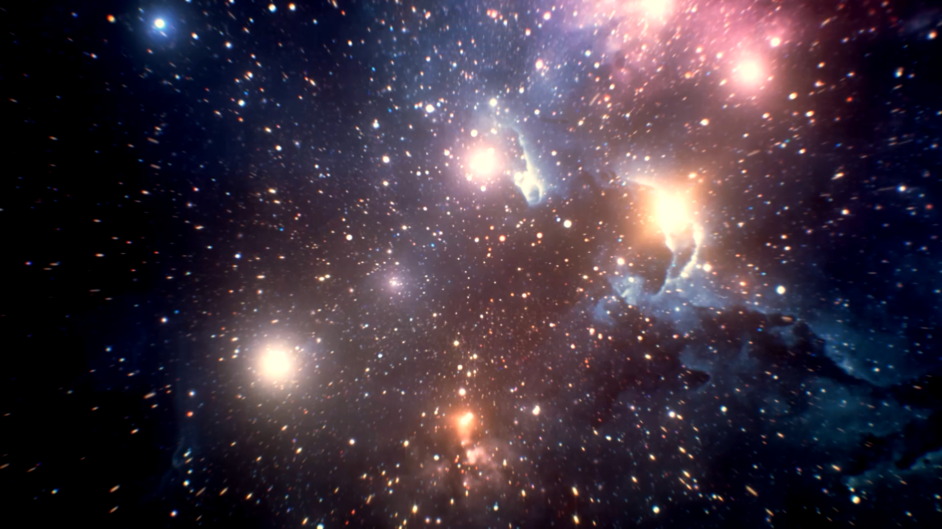
Atoms and Light
The Universe
IS #4

Slide 2
Lecture Recap
What is one thing you remember from the lecture?

Slide 3
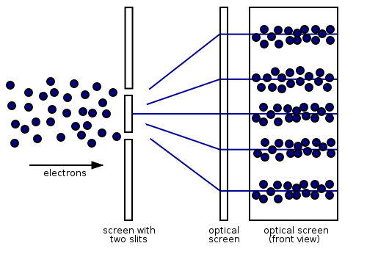
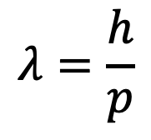
Matter wave-particle duality
Apart from EM waves (e.g. light), matter exhibits both wave and particle characteristics
De Broglie Equation:
$$λ=\frac{h}{p}$$
Notes:
Learnt that matter has wave-particle duality as well
De Broglie described a relationship between wavelength and momentum of such particles, known as de Broglie equation

Slide 4
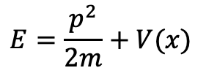
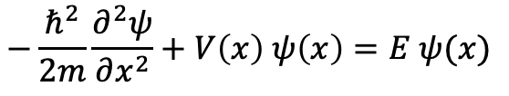
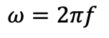
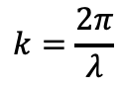
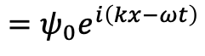
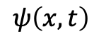
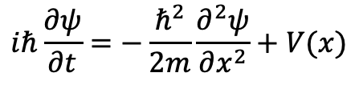
Wavefunction of Quantum Particles
From total conservation of energy and general wavefunction, 1-dimensional Schrödinger’s Equation (SE) was derived.
$$E=\frac{p^{2}}{2m}+V(x)$$
General wavefunction
Wavenumber
Angular frequency
$$ψ\left(x,t\right)$$
$$=ψ_{0}e^{i\left(kx−ωt\right)}$$
$$k=\frac{2π}{λ}$$
$$ω=2πf$$
Kinetic
Potential
Time-dependent 1D SE:
Time-independent 1D SE:
$$iℏ\frac{∂ψ}{∂t}=−\frac{ℏ^{2}}{2m}\frac{∂^{2}ψ}{∂x^{2}}+V(x)$$
$$−\frac{ℏ^{2}}{2m}\frac{∂^{2}ψ}{∂x^{2}}+V\left(x\right) ψ\left(x\right)=E ψ(x)$$
Notes:
Since particles can behave as waves, we are able to use a wavefunction to describe it Solving the wavefunctions gives the energy, position and momentum of the particles.

Slide 5
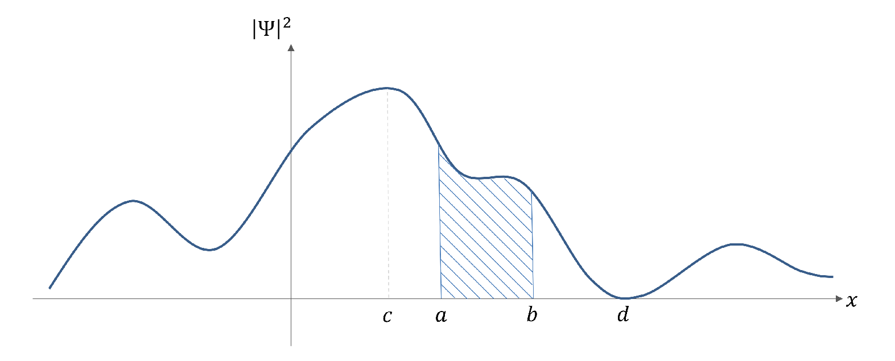
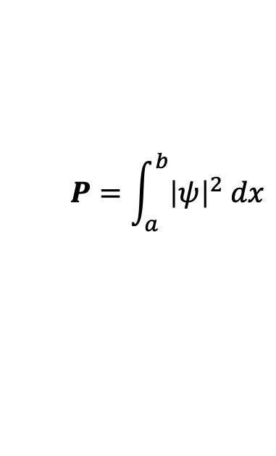
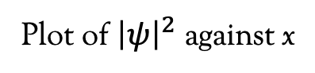
Probability Density Function
Plot of ${\left|ψ\right|}^{2}$ against x
P
Probability of finding the particle in region P :
$$P=\int_{a}^{b}{{\left|ψ\right|}^{2} dx}$$
Notes:
Wavefunction itself does not really have physical meaning. We can use it to find the probability of finding a particle at that position by using the probability density function.
Students have seen this same diagram in the lecture, can explain to them again since we might need it for Q8 if want to use it in PIAB.

Slide 6
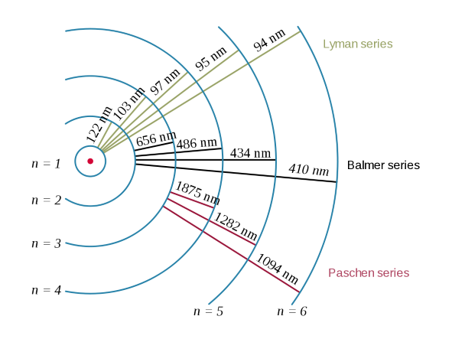
Recall: Bohr Model
Electron moves in circular orbit around the nucleus
The angular momentum of the electron is quantized
Electrons can transmit between allowed orbits by emitting or absorbing a photon
Notes:
Recall Bohr model, whereby Bohr assumed the electrons were particles.
Using the Bohr model, we now know that electrons orbit around the nucleus as wave.
Focus here is on postulates 1 and 2.
1. Electrons are confined within the orbit, so the wavefunction is considered to be confined within an orbit.
2.The angular momentum of the electron is quantized, meaning energy of wavefunction is quantized.
We want to find the wavefunction of the electrons but we start the most simple case…

Slide 7
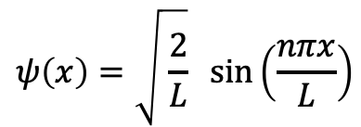
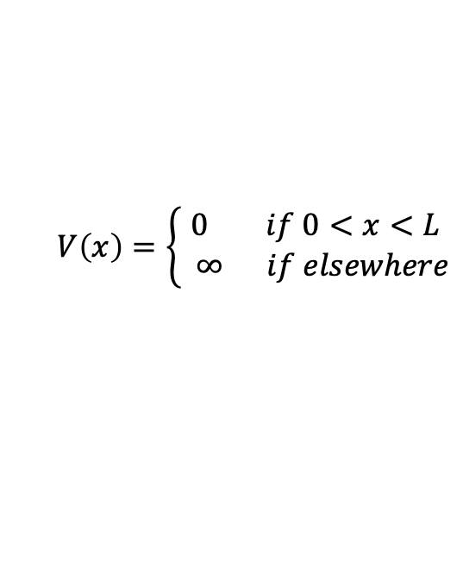
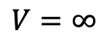
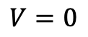
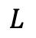
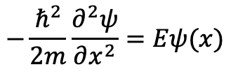

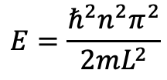
Particle in a box
Using a general wavefunction and SE,
$$V\left(x\right)=\left\{\begin{aligned}0 if 0<x<L \\ ∞ if elsewhere\end{aligned}\right.$$
$$−\frac{ℏ^{2}}{2m}\frac{∂^{2}ψ}{∂x^{2}}=Eψ(x)$$
Allowed energy states:
$$E=\frac{ℏ^{2}n^{2}π^{2}}{2mL^{2}}$$
$$V=∞$$
$$V=0$$
$$V=∞$$
$$ψ\left(x\right)=\sqrt{ \frac{2}{L}} \sin\left(\frac{nπx}{L}\right)$$
Allowed wavefunction:
$$0$$
$$L$$
Can you derive it?
Notes:
The 1-dimensional particle in a box
The expressions of wavefunction and the energy of a single particle in the box are given.
Can you derive it?

Slide 8

Discussion Questions

Slide 9
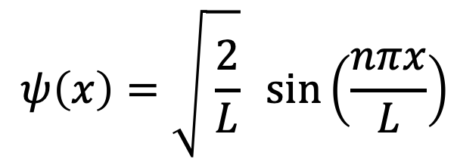
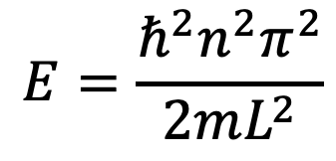
Q7
Derive the allowed energy states and wavefunction for particle in a box given Eq.(QM(15)) and Eq.(QM(16)).
Eq.(QM(15))
Eq.(QM(16))
$$ψ\left(x\right)=\sqrt{ \frac{2}{L}} \sin\left(\frac{nπx}{L}\right)$$
$$E=\frac{ℏ^{2}n^{2}π^{2}}{2mL^{2}}$$

Slide 10
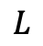
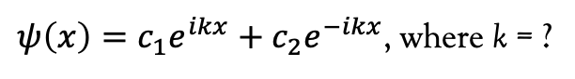

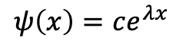
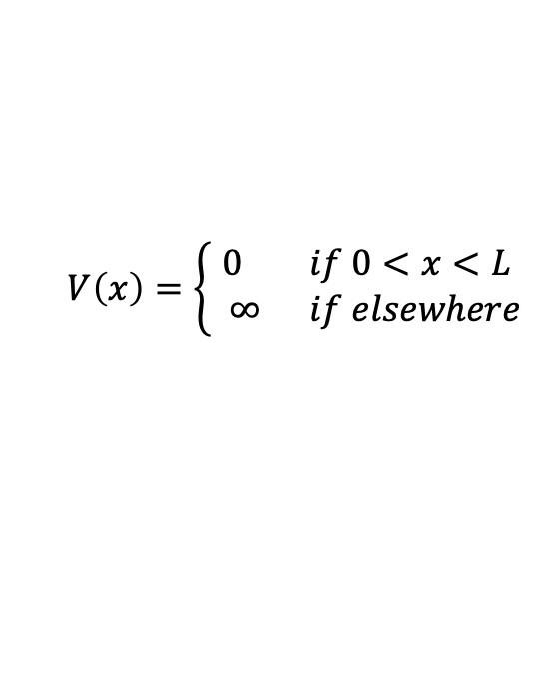
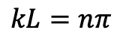
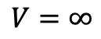
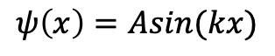
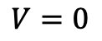
Q7 Hints
1. Start with an educated guess of the solution, for example:
2. Substitute into Schrödinger’s Equation (SE) and obtain the general solution:
3. Apply the boundary condition to obtain:
4. Probability density function to get Eq.(QM(16))
$$ψ\left(x\right)=ce^{λx}$$
$ψ\left(x\right)=c_{1}e^{ikx}+c_{2}e^{−ikx}$, where k = ?
$$ψ\left(x\right)=Asin(kx)$$
$$V\left(x\right)=\left\{\begin{aligned}0 if 0<x<L \\ ∞ if elsewhere\end{aligned}\right.$$
$$kL=nπ$$
$$V=∞$$
$$V=0$$
$$V=∞$$
$$0$$
$$L$$

Slide 11
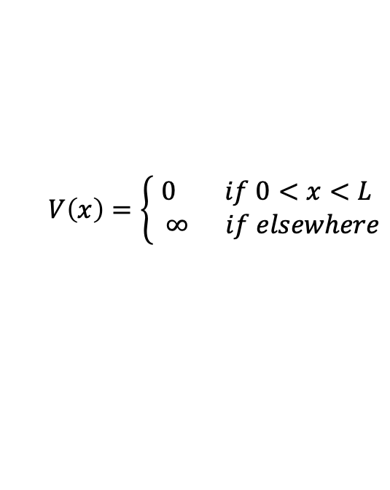
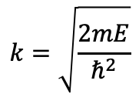
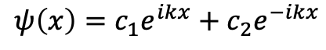
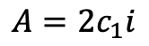
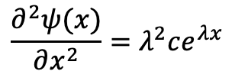
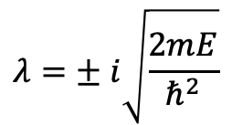
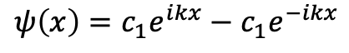
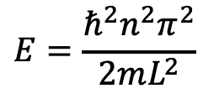
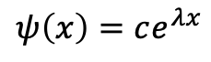
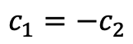
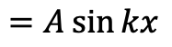
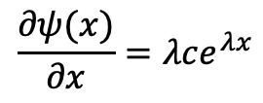
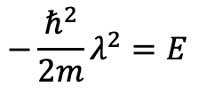
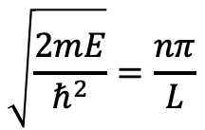
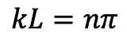
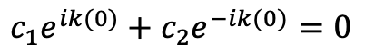
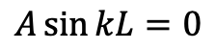
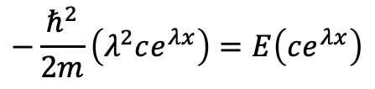
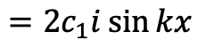




Q7 Solution
For boundary condition
$$V\left(0\right)=0$$
Given:
$$−\frac{ℏ^{2}}{2m}\left(λ^{2}ce^{λx}\right)=E\left(ce^{λx}\right)$$
$$c_{1}e^{ik(0)}+c_{2}e^{−ik(0)}=0$$
$$V\left(x\right)=\left\{\begin{aligned}0 if 0<x<L \\ ∞ if elsewhere\end{aligned}\right.$$
$$c_{1}=−c_{2}$$
$$−\frac{ℏ^{2}}{2m}λ^{2}=E$$
Apply Euler’s identity
$$ψ\left(x\right)=c_{1}e^{ikx}−c_{1}e^{−ikx}$$
Schrödinger’s Equation (SE):
$$λ=± i\sqrt{\frac{2mE}{ℏ^{2}}}$$
$$=c_{1}\left[\left(\cos{kx}+i\sin{kx}\right)−\left(\cos{kx}−i\sin{kx}\right)\right]$$
$$−\frac{ℏ^{2}}{2m}\frac{∂^{2}ψ}{∂x^{2}}=Eψ(x)$$
$$=2c_{1}i\sin{kx}$$
$$=A\sin{kx}$$
, where is arbitrary and
$$A=2c_{1}i$$
Sub into Eq. 1
Start with a general wavefunction
$$V\left(L\right)=0$$
$$ψ\left(x\right)=c_{1}e^{ikx}+c_{2}e^{−ikx}$$
$$A\sin{kL}=0$$
$$ψ\left(x\right)=ce^{λx}$$
Eq. 1
$$k=\sqrt{\frac{2mE}{ℏ^{2}}}$$
$$kL=nπ$$
, where n is a positive integer
$$\frac{∂ψ(x)}{∂x}=λce^{λx}$$
where
$$k=\frac{nπ}{L}$$
$$\frac{∂^{2}ψ(x)}{∂x^{2}}=λ^{2}ce^{λx}$$
Eq. 2
$$\sqrt{\frac{2mE}{ℏ^{2}}}=\frac{nπ}{L}$$
$$E=\frac{ℏ^{2}n^{2}π^{2}}{2mL^{2}}$$
Sub Eq. 1 and Eq. 2 into SE

Slide 12



















Q7 Solution
Sub Eq. 3 into Eq. 4
$$V\left(L\right)=0$$
$$−k^{2}ψ\left(x\right)=−\frac{2mE}{ℏ^{2}}ψ(x)$$
$$A\sin{kL}=0$$
Alternatively, since wavefunction of PIAB is a sin function,
Start with a general sin wavefunction:
$$k^{2}=\frac{2mE}{ℏ^{2}}$$
$$kL=nπ$$
, where n is a positive integer
$$k=±\sqrt{\frac{2mE}{ℏ^{2}}}$$
$$k=\frac{nπ}{L}$$
$$ψ\left(x\right)=A\sin{kx}$$
$$\frac{∂ψ(x)}{∂x}=A k\cos{kx}$$
$$\sqrt{\frac{2mE}{ℏ^{2}}}=\frac{nπ}{L}$$
Since $A\sin{kx=A\sin{(−kx)}},$
$$\frac{∂^{2}ψ(x)}{∂x^{2}}=−A k^{2}\sin{kx}=−k^{2} ψ(x)$$
$$k=\sqrt{\frac{2mE}{ℏ^{2}}}$$
Eq. 3
Schrödinger’s Equation (SE):
For boundary condition
$$E=\frac{ℏ^{2}n^{2}π^{2}}{2mL^{2}}$$
$$−\frac{ℏ^{2}}{2m}\frac{∂^{2}ψ}{∂x^{2}}=Eψ(x)$$
$$V\left(0\right)=0$$
$$A\sin{(k\left(0\right))}=0$$
$$\frac{∂^{2}ψ(x)}{∂x^{2}}=−\frac{2mE}{ℏ^{2}}ψ(x)$$
Eq. 4
$$A=0$$
Is a trivial solution

Slide 13
















Q7 Solution
Trigonometric identity
Apply trigonometric identity
$$\sin^{2}{x}+\cos^{2}{x}=1$$
$$\int_{0}^{L}{\frac{1}{2}−\frac{1}{2}\cos\left(\frac{2nπx}{L}\right)}dx=\frac{1}{A^{2}}$$
$$\cos\left(2x\right)=\cos^{2}{x}−\sin^{2}{x}$$
$$ψ(x)=A\sin\left(\frac{nπ}{L}x\right)$$
$$\cos\left(2x\right)=(1−\sin^{2}{x})−\sin^{2}{x}$$
Since particle is in the box, in other words, probability of finding the particle in the box is 1.
$$\int_{0}^{L}{1}dx−\frac{L}{2nπ}\int_{0}^{L}{\frac{2nπ}{L}\cos\left(\frac{2nπx}{L}\right)dx}=\frac{2}{A^{2}}$$
$$\sin^{2}{x=\frac{1−\cos{(2x)}}{2}}$$
$$\left(L−0\right)−\frac{L}{2nπ}\left(\sin\left(\frac{2nπ\left(0\right)}{L}\right)−\sin\left(\frac{2nπL}{L}\right)\right)=\frac{2}{A^{2}}$$
Use probability density function:
$$\int_{0}^{L}{ψ^{∗}\left(x\right)ψ(x)}dx=1$$
$$L−\frac{L}{2nπ}\left(\sin\left(0\right)−\sin\left(2nπ\right)\right)=\frac{2}{A^{2}}$$
$$\int_{0}^{L}{A^{2}\sin^{2}\left(\frac{nπx}{L}\right)}dx=1$$
$$L=\frac{2}{A^{2}}$$
$$ψ\left(x\right)=\sqrt{ \frac{2}{L}} \sin\left(\frac{nπx}{L}\right)$$
$$\int_{0}^{L}{\sin^{2}\left(\frac{nπx}{L}\right)}dx=\frac{1}{A^{2}}$$
$$A=\sqrt{ \frac{2}{L} }$$
Sub back into wavefunction $ψ(x)$

Slide 14
Q8
Graph the particle in a box wavefunction for n = 1, 2 and 3. Label each sketch with the value of energy associated with each n.

Slide 15






Q8 Solution
$$E=\frac{ℏ^{2}n^{2}π^{2}}{2mL^{2}}$$
$$ψ\left(x\right)=\sqrt{ \frac{2}{L}} \sin\left(\frac{nπx}{L}\right)$$
Since $E∝n^{2}$, energy of particles increase as n increases. What other variables can affect the energy? Test it out yourself!
There are also positions whereby $ψ\left(x\right)=0$, known as nodes. At these positions, probability density function shows that particles do not exist there! As n increases, the number of nodes increases.
What happens when $n →∞$ ?
Notes:
Students should use these two expressions to plot the wavefunctions.
Can show them that wavefunctions become continuous as n -> infinity.
https://colab.research.google.com/drive/10Ivx0aLvItvvcFt8_rTsArm57fOlvTQh?usp=sharing

